Slide 1
AN AGILE DEVELOPMENT METHODOLOGY
Code Quality Assurance
Code Quality Assurance
The Agile Process Team
Brad Huett Don Kasner
Megan Schmid Dave Latham
Erich Villasis Steven Hill
Siva Natarajan Bryce Budd
Sunday, January 19, 2014

Slide 2
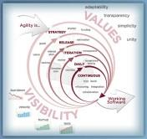
What is Code Quality Assurance?
The Code Development Quality Review Process
The “Product” delivered in Software Development is complied and script code along with supporting files such as images, XML, Style sheets and other file types. Like any other product manufactured, a quality control process must be in place to protect the Customer.
The QA Team ensures that the product performs as expected for the Customer. This is the end result of the Code Quality process. Code quality must be monitored and validated throughout the “Manufacturing” process.
The Code Development Quality Review Process unifies the commitment of delivering Sprint User Story Points
to QA with the fewest possible development issues.

Slide 3
How does the Code Quality Assurance process help QA?
Optimizing the Efforts of the QA Team
The Code Review Process creates strong Development Team integration with the Architect Team and the QA Team by using the Agile "One Team" philosophy for fostering creative cooperation.
The process creates an environment that fosters the QA Team to spend their time on real bug and performance testing.
The QA Team's effort is directed toward discovery of issues that were not found in the integration test suite, the QA Objective, as the developer’s "Happy and Sad Tests".
This process enables the QA Team's daily activity to concentrate on real world code issues. The process eliminates the costly "Gotcha" game that some QA Teams play with the Development Team.

Slide 4
What is the Code Review QA Objective?
Optimizing the Efforts of the Development Team
The QA Objective supports the real “Objective” of developing high quality code that QA testing validates to support this concept:
Quality Business Solutions that Controls
... The Cost of Delivery and Maintenance
...... Over the Software Development Life Cycle
The term “QA Objective” refers to the QA Team Test Suite that exercises the Sprint Feature Story Scenarios developed as the code base.
The QA Objective ensures that the Development Review Certification process meets the Business Team’s User Story Acceptance Criteria for all delivered code.
The QA Objective supports the Sprint concept of "Definition of Done“.

Slide 5
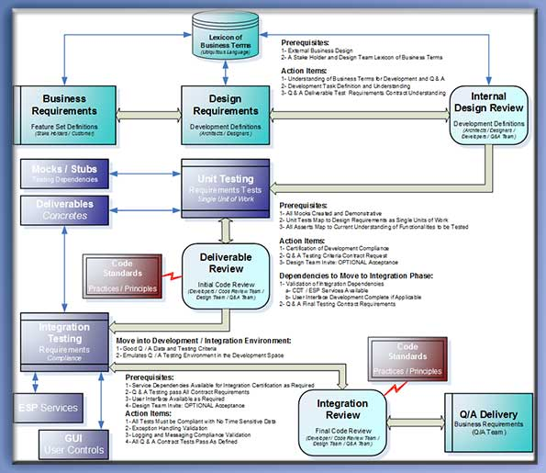
What is the Development Review Certification Process?
Certifying the Product BEFORE QA Testing
The preeminent goal of the Development Team is to deliver code that is as “Bullet Proof” as possible. This means achieving a high level of functionality with a low count of code issues: Bugs.
The Three Phase Review Process:
The Internal Design Review – Introduction of a possible development solution course of action
The Deliverable Review – Validation of the Test Driven Development Unit Testing standards
The Integration Review – Integration of System dependencies and certification of the QA Objective

Slide 6
What is Phase One Code Quality Assurance?
Phase One: The Internal Design Review
The process begins with a Business User Story selected for Sprint development. That story is transformed into a Technology Feature Story with Task Scenarios that map to the User Story Acceptance Criteria. A joint effort between the Architect, Development and QA teams create the initial design and the QA testing criteria that forms the QA Objective.
Before the development begins an Internal Design Review is conducted to ensure that the Business Acceptance Criteria has been understood, using the Ubiquitous Language, and the representation of the criteria will be correct when presented within a the Acceptance Testing web page display. The Design SOW document is the roadmap for development.
This review is referred to as “Internal” because it is primarily the delivery team that creates the acceptance criteria the Business Stakeholders will validate using the Acceptance Test Web page.

Slide 7
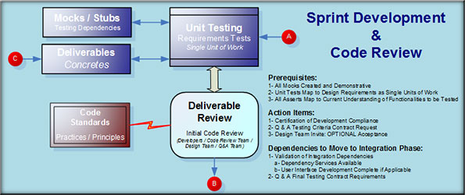
What is Phase Two Code Quality Assurance?
Phase Two: The Deliverable Review
This review is held during the Sprint iteration for the code base developed using true Unit Tests. All external dependencies mocked for this review.
The developer’s code base is reviewed using the Developer’s Unit Test Suite within the Development environment. A representative from the QA Team can be a member of this review to ensure that the understanding of the QA Objective from the Design Review is correct.
The QA representative leaves the review with a clear direction of the QA Objective delivery criteria. This understanding must be based on the concrete representation of the code base as demonstrated during the Development Code Review.
This direction should help refine the QA Objective that has formed the Test suite and Use Cases created after the Sprint Design Review.

Slide 8
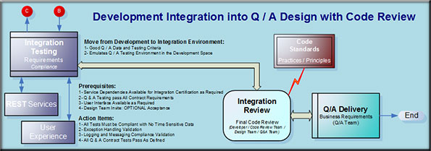
What is Phase Three Code Quality Assurance?
Phase Three: The Integration Review
This Code Review is held before the developed code base is released to the QA Team as a validation that the QA Objective has been certified.
The code base is tested in the QA environment but not released to the QA Team until the Integration Review is completed and certified as a successfully validation of the code base.
The certification criterion for the Integration Review code is QA Objective Test Suite and all Use Cases using the QA team’s test data. The Integration Review Lead certifies the passing code base. It is now ready for delivery to the QA Team.
The Integration Review Lead notifies the QA Team that the developed scenario has met the QA Objective and is ready for testing.

Slide 9
In Conclusion: Code Quality Assurance
The Preeminent Development Responsibility
The Code Quality Assurance process is a structured balance of Team Cooperation and Defined Processes. The goal, as always, is to reduce the Cost of Software Development through the use of Agile Methodologies.
The "One Team" philosophy of Agile is expanded in the Code Review process to prevent issues related to the traditional adversarial relationship between the Development Team and the QA Team.
The preeminent objective of the Code Review process is to deliver to the QA Team developed code that has been pre-tested for compliance with the Business Team’s Success Criteria as defined by the QA Objective
This objective creates an environment where the QA Team can efficiently concentrate on finding issues that the developers had not thought of during the development activities.
... The Concept of Giving the Developers the Test Suite
...... Is like Giving a Student the Answers to a Test
... Violates the Preeminent Responsibility of the QA Team
...... Efficient Use of QA Resources for the Business Team's Success Criteria

