Slide 1
AN AGILE DEVELOPMENT METHODOLOGY
The Code Development Process
The Code Development Process
The Agile Process Team
Brad Huett Don Kasner
Megan Schmid Dave Latham
Erich Villasis Steven Hill
Siva Natarajan Bryce Budd
Sunday, January 19, 2014

Slide 2
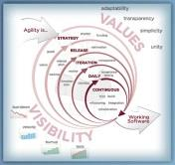
What is Missing in the Traditional Development Process?
The Challenges with Traditional Development
The management of a traditional project consists of a project management tool to document the reported progress by the Development Team and the supporting Solutions Teams.
This process queries the development resource for a percentage of completion of assigned task. The progress is tracked to completion of 100% of the assigned task.
The assumption at this point is that the acceptance criteria requirements have been successfully completed.
... This Process Lacks Validation of Delivery
...... There are No "Teeth" in this Process
The Problems with the Traditional Process:
It is an “Open Loop” process that only report possible development efforts
There is not a process that validates that a viable solution was ever created
It is a “Fox in the Hen House” process: The Developer validates its own work completion
The current state of development for the Business Stakeholder’s Acceptance Criteria cannot be monitored by the most important team: The Business Team
Change Requests for a given delivered Acceptance task cannot be easily regressively tested and reports viewed by the Business Team
We need a “Closed Loop” Process that Validates that the Acceptance Criteria has been Verifiable

Slide 3
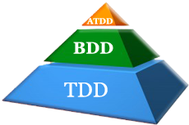
What is the “Closed Loop” Development Process?
A Self Reporting Quality Managed Development Process
We need a development process that manages code development that is more than a status in a document. We need a process that puts “Teeth” into the process of creating the code base that fulfils the Business User Story Acceptance Criteria.
This “Closed Loop” Development Process is called “Alphabet Development”
Acceptance Test Driven Development (ATDD) – The defining of Business Domain Requirements to Technology Domain Model acceptance criteria.
Behavior Driven Development (BDD) – The development process of mapping the Technology Domain Model acceptance criteria to clear Development Scenarios that creates self-descriptive code
Test Driven Development (TDD) – The development paradigm that ensures that new code first defines the “What” as a Single Unit of Work method test within the testing assembly prior to creating the “How” as a successful test that exercises the developed code base.
The Alphabet Development Process uses Acceptance Test Driven Development (ATDD) to map business user story acceptance criteria to Behavior Driven Development (BDD) scenarios for developers to deliver quality code using Test Driven Development (TDD)

Slide 4
What is the Alphabet Development Process?
A Development Process for All of the Team Members
Most of the Agile teams concentrate on the design, development, the quality of the delivered code base through product tests and management of the processes and technology requirement.
The most important team members are the Stakeholders and the Business Team’s Subject Matter Experts. Unfortunately these members are involved primarily in the beginning stages, given periodic reports and then see the resulting product at some point in a product demonstration.
Alphabet Development involves Business throughout the Entire Development Process through Real-time Development Reports
Development Progress Reports are created automatically every time the Continuous Build is generated. These Web reports are updated and viewable by a team members.
Business Delivers the User Story Developers and QA Creates the Tasks Code Developed
Acceptance Test Driven Development Behavior Driven Development Test Driven Development
Behavior Driven Design, using SpecFlow, displays the current state of development to all Team Members using Web Reports that Maps the Acceptance Criteria for the Teams to view

Slide 5
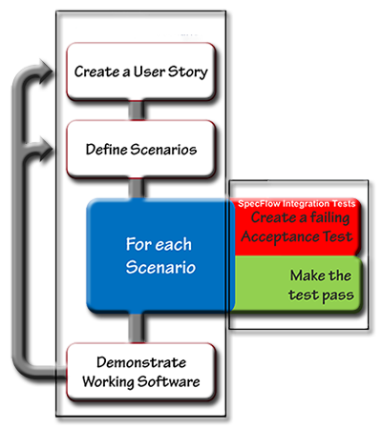
What is the “Vertical” Test Driven Process?
Acceptance Test Driven Development with Behavior Driven Development
The Acceptance Test Driven Development Process creates a vehicle for the Business Team’s Stakeholders and Subject Matter Experts to have continuous access to the progress of the current Sprint development process.
The Business Acceptance Criteria has been defined for the developer as an Acceptance Scenario Development Task as defined in the Sprint Planning process
An ATDD Web page has been created for viewing by the Business Team
The Business Team validates that the “YELLOW” Acceptance Criteria Scenario test has been defined correctly by the Architect Team
Once the Business Team certifies that the defined expected results have been interpreted correctly, the BDD test is moved from the “YELLOW” stage to the “RED” accepted but not yet started stage
The current stage of all BDD Acceptance Scenario tests are viewable, at all times, by all Team Members
The Development Scenario Task is accepted by the assigned Developer for development and moved to Test Driven Development
Once the “RED” test acceptance criteria has been certified by the QA Team as completed TDD horizontal tests, the highest level of abstraction, the Web Services in the Services Stack or the Application Controller in the Web Application Stack, is then repurposed for the Acceptance Scenario’s “GREEN” test vertical validation
This process produces the “Teeth” that validate that the Business expectations have been Designed Developed, QA tested and ready for deployment to the emulated Production Environment: Staging

Slide 6
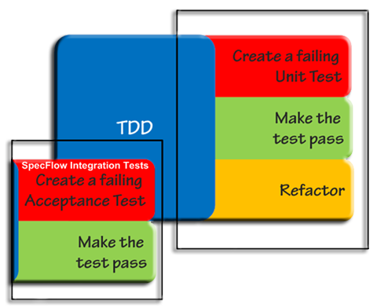
What is the “Horizontal” Test Driven Process?
Test Driven Development (TDD)
The Test Driven Development Process is a radicle change to most developers “Comfort Zone”. It requires the Developer to clearing understand the “What” of a code solution prior to any code being developed.
The process also require discipline in development by creating and code that moves the process from the RED test to the GREEN be creating and validated within the Test Assembly and not the Project Assembly under development.
The Test Suite contains folders that map to the namespace structure of the Assemble Under Test (AUT).
The Gherkin Language format of: GIVEN/WHEN/THEN
GIVEN - The class name: “GivenIWantToTestTheCustomerClass”
WHEN - What the test is going to exercise: “WhenICallTheCreateCustomerInfoMethod_”
THEN - What I am going to assert is true: “_ThenIWillValidateTheResultObjectIsValid”
This format helps the developer comply with the Single Responsibility Principle. Only one Method can be tested but multiple assertion will validate the result object

Slide 7
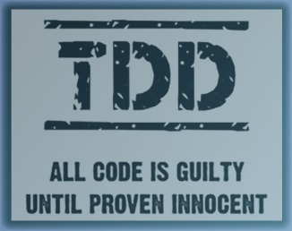
What is the Test Driven Development Process?
Test Driven Development: Step by Step
The assigned task Developer creates the concrete solutions using the Test Driven Development (TDD) process
Development begins with generating a “RED” failing test that acts as a “To Do” list for the Developers development process
The “RED” tests become “GREEN” working Unit Tests consuming “Mock” dependencies as Single Unit of Work true unit tests
The Unit Tests, within the test assembly, are made “GREEN” using any means possible
Best Practices and Code Standards are waived at this stage and do not have to be in full compliance if it will validate the developers design premises as quickly as possible
The functional “GREEN” test code is moved to the Project Assembly Module in the proper namespace folder structure.
The “GREEN” tests are run again to validate that the code has been migrated successfully
The final “YELLOW” stage of TDD is the Refactor Stage Team Members
The Working “GREEN” test are refactored into Objected Oriented Programming Best Practices using the TMD Design Principles, Code Standards and relevant Design Patterns that will allow the code base to pass the Code Review process
The completed “YELLOW” code base is submitted for Design Code Review and certified ready for the Application Integration development Stage
The approved Developed code is integrated into the Development Environment as an integrated design deliverable
All Code base Unit Tests are cloned into Integration Tests within the Test assemblies
The Unit Tests are marked as “IGNORED” in the Test Assemblies in order to improve automated testing run performance as the code base under test is being exercised by the Integration Tests at this point and the Unit Tests would be redundant and time-consuming
The passing integration code base is submitted for Integration Review to ensure that the QA Objectives has been met before delivery to the QA Environment for QA Certification
Once all horizontal TDD code has been certified by the QA Team that it meets the QA Objectives then the code is returned to the BDD development process for refactoring into the “GREEN” BDD tests for viewing on the ATDD Website by all Team Members

Slide 8
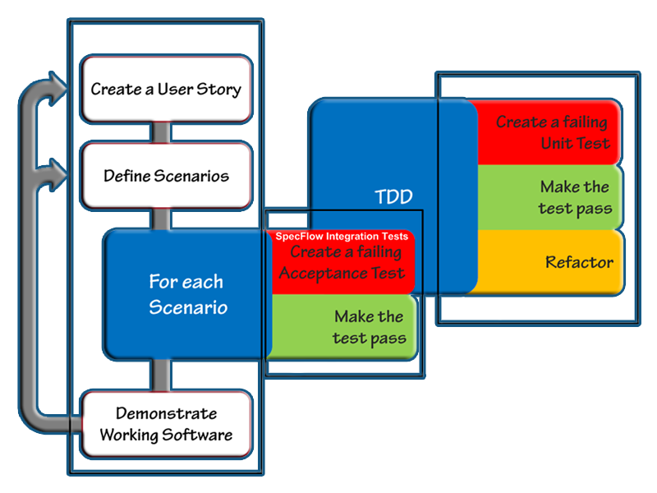
In Conclusion: The Code Development Process
Keeping Our “Eye on the Ball” in Software Development
Some may say that this process adds unnecessary complexity to the development process. Software development is inherently “Complex”. As Steven McConnell stated in his book Code Complete 2: “Software's Primary Imperative is to Manage Complexity”.
The community that supports the concepts defined above disagree that it add unnecessary complexity. They believe that the processes creates business solutions that are simpler for management over time which lowers the Cost of Ownership (TCO). This process develops a code base that is driven by Automated Tests to help Code Maintenance Teams use their time more efficiently over the software life cycle.
The processes add a greater Degree of Clarity during development that far outweighs the relatively short learning curve required by all the teams to gain the quantifiable benefits of the Development process

