Slide 1
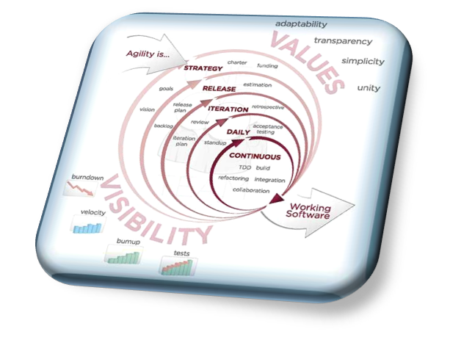
AN AGILE DEVELOPMENT METHODOLOGY
The QA Process
The QA Process
The Agile Process Team
Brad Huett Don Kasner
Megan Schmid Dave Latham
Erich Villasis Steven Hill
Siva Natarajan Bryce Budd
Thursday, February 06, 2014

Slide 2
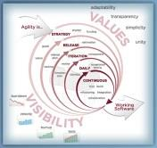
What is the QA Global Delivery Service Governance Model?
3-Tier QA Governance Model
Strategic Partnership
Strategy Relationship
Transformation
Gain Sharing
Supplier Relationship Scorecard
j
Strategic partnerships will evolve based on progress on project and maturity of the project
Goals
Delivery Assurance
Progress Reporting
Escalations
Strategic Direction
Long term planning
QA Reports
Daily
Weekly
Bi-Weekly
Escalations
Budget and Resource
Resource Plan
Issue / Risk
The engagement Governance Model focuses on establishing cost effective outsourcing operations, effective delivery processes and Performance Measurements.
Executive Level
Quarterly or Half Yearly Strategic Meetings
Performance/Achievements
Strategic Direction & Alignment
Transformation Review
LH
Account Leadership Team
Trion
Leadership Team
Management Level
Bi-weekly or Monthly Meetings
Reviews,
Metrics, Trends, Causal Analysis
Escalations
Future Work
Trion TCoE lead &
Managers
LH QA
Lead / Managers
Weekly Meetings
Project Status – Quality
Issue Resolution
Staffing
Reviews
Delivery Teams
Client Team/ Existing Vendor
LH QA Team

Slide 3
The Steering Committee Quality Report Dashboard: Defects by Severity
Open Defects by Severity:

Slide 4
The Steering Committee Quality Report Dashboard: Defects by Age
Open Defects by Age:

Slide 5
The Steering Committee Quality Report Dashboard: Test Cases
Test Case Report:

Slide 6
What are the QA Report Types?
Quality Assurance Reports:
Report | Purpose | Frequency | Scope | Audience | Distribution**
Defect | Daily progress check | Daily | Sprint | Dev Lead / QA Lead | Self Serve
Weekly Defect | Weekly progress check, Escalation | Weekly | Sprint |  | Email / Repository
End of the sprint | Overall progress, burn down, escalation, Quality Gates | End of the sprint | Sprint | Dev Leads + QA Leads + Scrum Masters | Email + Repository + Meeting
Steering Committee | Progress report, escalation, course correction | Every other week | Project | Governance Team | Repository + Meeting
Budget | Burn report | Every other week | Project | Governance Team | Repository + Meeting

Slide 7
What are the Daily Metrics?
Daily Metric Details:
Metric | Purpose | Unit of Measurement
Stories by Status(Actual Stories Completed vs. Committed Stories) | Will help us to identify current backlog status by effort (story points) or remaining time. | Story Points
Open Defects Count Closed Defect Count Reopen Defect Count | Overall quality activity measurement for the sprint | Defects Counts
Defects Trending Report | Ensures that as the end of the sprint approaches, the quality of the release is high | NA
Test Case Trending Report | how many test cases are run for each sprint, and how many passed and failed, day-by-day | NA
Feature Burndown Chart | Helps in determining the progress towards Sprint Goal | Story Points (or hours)
Metrics are collected from JIRA report
Report distribution : Team Member’s create their Jira dashboard reports

Slide 8
What are the Generated Sprint Metrics?
Sprint Data Metric Details from Jira:
Metric | Purpose | Unit of Measurement
Sprint Velocity | Will help us to track achieved velocity and estimate the velocity of the next sprint. | Story Points
Release Burn Down Chart | Total Sprint Tasks completion achieved per day. | Task Items assigned to Sprint Feature Story
Defect Removal Efficiency | Number of defects logged by Product owner --------------------------------------------------- * 100 Total Defects logged in the current Sprint. | Open Defects Count
Reliability | The ability of teams to meet the Story Points they committed to for a Sprint Committed Story Points /Earned Story Points | Story Points
Estimation Accuracy | The ability of teams to accurately estimate their work. Estimated amount of effort/Actual amount of effort. | NA
Ratio of Successful Sprints | The degree to which the team is able to meet their commitment. Successful Sprints /Total Sprints | Story Points
Test execution coverage | # of Test Cases Executed ---------------------------------------------------- * 100 # of Test Cases planned for Execution | NA
Quality Efficiency | Measures quality of code based on effort required to fix defects. | NA

Slide 9
What are the Sprint Metrics Definitions?
Sprint Data Metric Definitions:
Defect Status
New, Open(In-Progress), Non-Issue(duplicate, non issue), Ready For QA, Resolved, Closed
Defect Severity
Critical, High, Medium, Low
Defect Data
Current Sprint : Defects by severity and status
Total for Work stream: Defects by severity and status
Defect moving to future sprint : Defects by severity and status
Defect added to current sprint from previous work or other work streams: Defects by severity and status
Defects from Adhoc Testing : Defects by severity and status
Total reopen Defects: Defects by severity and Status
Even if it is closed, we need to report how many defects where reopened)
Test Case Data
Current Sprint: Total, Approved, Executed, Closed, Failed
Sprint: Total, Approved, Executed, Closed, Failed
Total for Work Stream: Total, Approved, Executed, Closed, Failed
Productivity Metrics
Average time taken to generate test cases (including rework / approval)
Test Case Coverage Effectiveness = (Defects found due to test case * 100 ) / Total defects
Defect removal Efficiency = (defects resolved in sprint * 100 ) / defects found in a sprint
Defect removal quality = reopened defects / total defects

Slide 10
What are the Roles and Responsibilities for the QA Team: Part One?
Roles | Responsibility | Deliverables
CoE Consultant | 50% Consulting Resource that Partners with the Director of QA \ Release Management on implementing the Testing Center of Excellence (CoE), Defining the Test Strategy used on and off shore resources, participates in the initial screening of candidate. | CoE Implementation Plan Quality Process documentation Tool identification and Initial Tool Review Initial screening and sourcing for potential Metric Report implementation
QA Lead | Coordinates tasks QA Analysts, servers a SME for the team, Approves Test Data & Scenarios used, Defines and executes Test Cases used NOTE – The QA Lead will focus on the 6.0 Initiative and leading the QA Effort with direction from the Director of QA \ Release Management | Acceptance Criteria Test Data and Test Cases Sprint Test Report Test Defect Report Sprint Review Demo
External QA Lead | Coordinates tasks QA Analysts, servers a SME for the team, Conducts training for new resources, Defines Test Data & Scenarios used, Defines and executes Test Cases used | Acceptance Criteria Training Schedule for off-shore resources Test Data and Test Cases Sprint Test Report Sprint Review Demo Test Defect Report
Integration / UAT QA team | Development of the Integration Scenarios, working with the Business partners on UAT, Development and Maintaining Regression Testing, Recommends scenarios for Automation | Test Data and Test Cases Test Defect Report
Automation Engineer | Development and Maintaining Automation testing scripts and data | Automation Tool identification and implementation Automation script execution
Performance Engineer | Development and Maintaining Performance testing scripts and data | Test Scripts for Load Summary of application performance under load

Slide 11
What are the Roles and Responsibilities for the QA Team: Part Two?
Roles | Responsibility | Deliverables
QA Engineer | Supports the sprint team by defining Acceptance Criteria, Supports the Development effort through assisting in Unit Test creation, Defines Test Data & Scenarios used, Defines and executes Test Cases used | Acceptance Criteria Test Data and Test Cases Test Defect Report
 | Supports the Business by providing initial level application support through Training, Guidance, Issue Triage NOTE – Requires Business and Application Domain Knowledge | Troubleshooting via Work Order Tracking System User Manual Updates and Training per bug \ enhancement
Release Management Support | Coordinates application related changes from inception to roll-out, focusing on sign-off, communication, issue escalation, etc. | Status Reports Deployment strategy User Manual Updates and Training per change
Project Manager | Project support for IT Related projects | Project Plans developed and Status reports Communication Plans
Director of QA \ Release Management | Oversees the organization with a focus on implementing standards and best practices. In addition, will coordinate the 6.0 testing initiative while leading the 5.X testing initiative.

