Slide 1
AN AGILE DEVELOPMENT METHODOLOGY
The Sprint Iteration Daily Activities
The Sprint Iteration Daily Activities
The Agile Process Team
Brad Huett Don Kasner
Megan Schmid Dave Latham
Erich Villasis Steven Hill
Siva Natarajan Bryce Budd
Friday, February 21, 2014

Slide 2
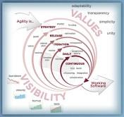
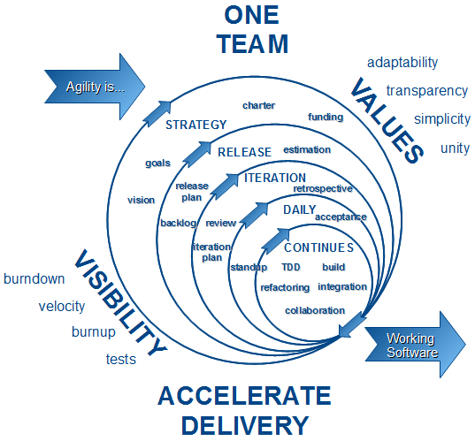
What are the Sprint Iteration Daily Activities?
Managing the Sprint Planning, Execution and Retrospective Process
The Agile Sprint development iteration cycle is two calendar weeks, ten business days. Within the current Sprint there are numerous “Next Sprint” planning activities and “Post Sprint” activities. These activities are designed into the Sprint Team members “Capacity”, the hours available each day dedicated to the current Sprint.
The Schedule of the Current Sprint Days:
The Sprint Daily Activities – The ten days of the current Sprint
The Sprint Planning Activities – The “Minus Six” days beginning on Day Five of the current Sprint
The Post Sprint Activities – The “Plus Two” days beginning on Day One of the current Sprint
The first week of the Sprint begins with the Business Team demonstration of the newly developed product and ends with the Business and Development teams with QA next Sprint planning.

Slide 3
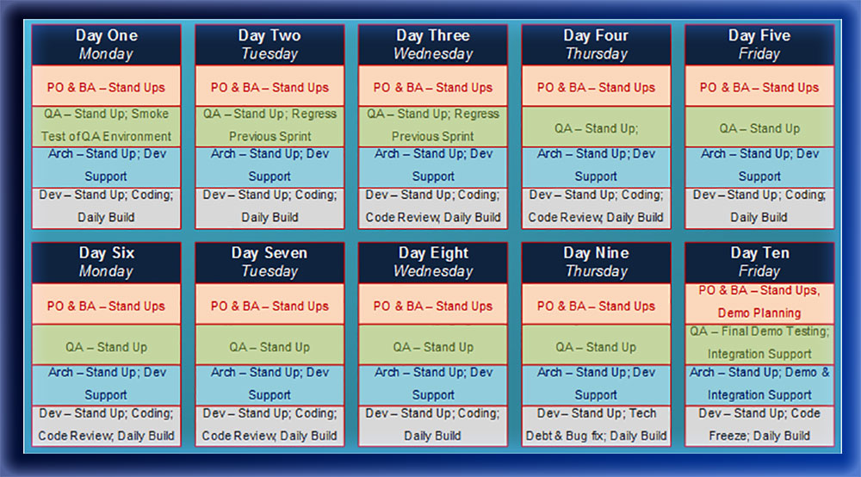
What are the Sprint Daily Activities?
The Current Two Week Sprint Daily Schedule
The Sprint cycle is two calendar weeks, ten business days. There are Sprint Planning Activities and previous Sprint activities schedules along with the current Sprint activities.
Sprint planning creates capacity for each team member’s responsibilities: Sprint Planning, Current Sprint Activities and Post Sprint Product Deployment Retrospective

Slide 4
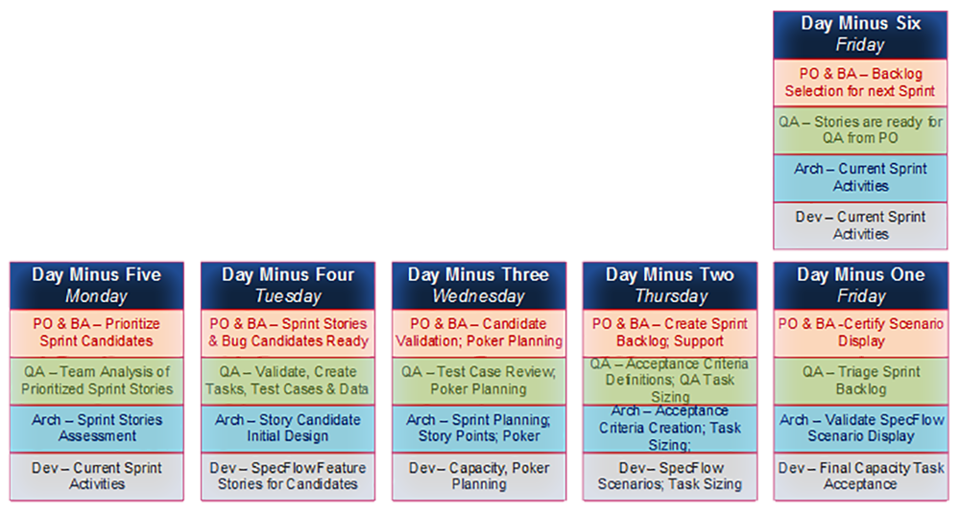
What are the Sprint Planning Daily Activities?
The Next Sprint Planning Daily Schedule
The Agile Sprint development methodology is based on a continuous development cycle. This model requires that three Sprint responsibilities occurs simultaneously: Planning, Development and Delivery with a Sprint Retrospective.
The Print Planning Days: Six Day Planning Count Down
Days Minus Six to Minus Four – Business backlog grooming and selection of User Story candidates. The Teams creates the initial test cases, tests suite and test data. This generates the QA Objective.
Days Minus Three to Minus One – The Teams choose the User Stories for the next Sprint, create the Story Points used to track Sprint Velocity. The Developers size the points into tasks accept the Feature Story Scenarios as assignments for development.
By the last day of the current Sprint, all issues for the next Sprint are resolved. The team is ready to start the next iteration on the following Monday: Day One of the New Sprint & Day Plus One of the Old Sprint

Slide 5
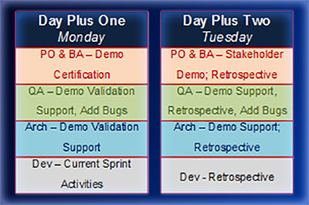
What are the Post Sprint Daily Activities?
The Previous Sprint Product Business Demo and Retrospective
The first two days of the new Sprint are the last two days of the old Sprint. These days are for Business demonstration preparation and demonstration of the new product developed during the last Sprint.
Days Plus One – The code pushed to the Demo Environment on Day Ten of the last Sprint is validated on Day Plus One. A test demonstration script is created and performed, a “Dress Rehearsal”, until all issues have been resolved.
Days Plus Two – Every other Tuesday morning a Business Stakeholders and Subject Matter Experts Showcase Presentation is held. The demonstration of the new Product is conducted to confirm compliance with the expectations of the Business Owners, and all other interested personnel, based on their Acceptance Criteria. Any issues, change requests and general comments are noted for planning into the next Sprint.
The lessons learned from the Sprint Retrospective are fine-tunes during the week and presented for implementation on Day Minus Six: First day of the next Sprint.

Slide 6
In Conclusion: The Sprint Iteration Daily Activities
A Closed Loop Activities Process
The Development Process ensures quality development by implementing a “Closed Loop” process using Alphabet Development. The Iteration Activities process implements its own “Closed Loop” process.
By overlaying the new Sprint Planning and Post Sprint Retrospective on top of the current Sprint we can collect the Business drivers input from the demonstration of the delivered Product and implementing the changes immediately in the planning of the upcoming Sprint.
This creates a dynamic Sprint Wisdom Triangle:
Sprint Data – Sprint Metric data is collected during the Sprint.
Sprint Information – Other information about the daily activities are assimilated and stored for correlation during the Sprint Retrospective.
Sprint Knowledge – The Sprint Retrospective analyzes and dissects the acquired Information and generates Knowledge about the Strengths, Weaknesses, Opportunities and Threats through the S.M.A.R.T. process of assessment
Sprint Wisdom – Wisdom is gained when Knowledge is put into use to create a positive result. The information from the retrospective is used immediately.
Sprint Wisdom gained during each Sprint iteration is available for immediate use to create new Data. This Information generates Sprint Knowledge used to gain reusable Sprint Iteration Wisdom for the new Sprint

