Slide 1
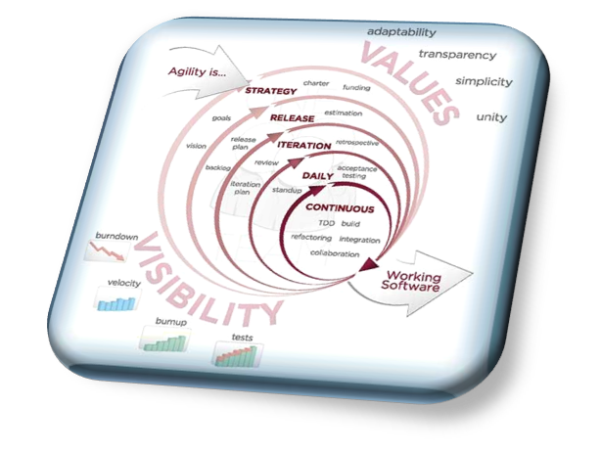
AN AGILE DEVELOPMENT METHODOLOGY
The Ubiquitous Language
The Ubiquitous Language
The Agile Process Team
Brad Huett Don Kasner
Megan Schmid Dave Latham
Erich Villasis Steven Hill
Siva Natarajan Bryce Budd
Saturday, January 18, 2014

Slide 2
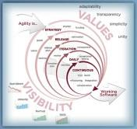
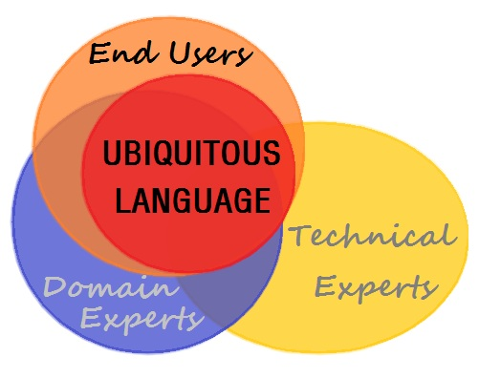
What is the Ubiquitous Language?
The Ubiquitous Language: A Lexicon of Business Terms
The Ubiquitous Language is a collection of Business Terms that must be understood and realized in the same way by all Team Members.
The language is used in all communications and it becomes the Naming Convention for all code development.
The lexicon is a "Living Dictionary" that must be proactively managed throughout the entire Software Development Life Cycle.

Slide 3
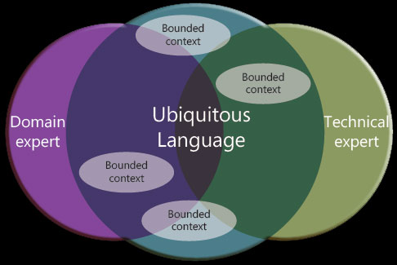
Why do we need a Ubiquitous Language?
The Ubiquitous Language in Software Development
The Software Development process requires numerous human beings to become intimately involved for the project for the initiative to be successful.
Each member of the Business Group and the Solution Provider’s team has a unique perspective of the project and the definition of any term that the member hears.
A misunderstanding of terms deemed as understood by the teams can lead to complete failure of the Client’s Business definition of success.

Slide 4
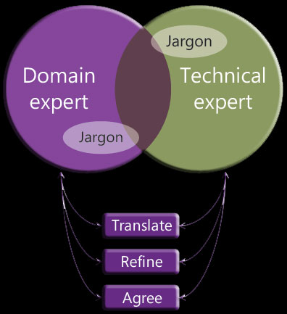
How is the Ubiquitous Language Implemented?
The Ubiquitous Language Defines Development
The Lexicon of Terms globally available to all Agile Teams for reference and maintenance throughout the life cycle of the Business initiative.
All development naming conventions are driven by the Lexicon of Terms. Code Assemblies, Classes, Methods and Properties comply with the lexicon.
The Goal is to create the Dictionary of Terms from translated words and phrases that are refined in to a Ubiquitous Language that all Business and Team members agree upon as common meanings
The terms are always driven by the Business Domain requirements and augmented by the Architecture

Slide 5
What are Ubiquitous Language Change Requests?
Changes to the Lexicon of Terms
The successful management of the Ubiquitous Language's lexicon of terms must implement the following requirements on a daily basis:
Deemed important and mandated by the highest level of management
A dedicated lexicon management resource, the Lexicon Master, must be assigned to the initiative
The Lexicon Master must be held accountable for the accuracy of the current state of the Lexicon's definitions
A manageable Change Management process must be enforced
A Change Request approval process must be in-place to ensure changes add real value to the project
The impact of the changes to the Lexicon must be completed through a due diligence process

Slide 6
How is the Ubiquitous Language Managed?
The Lexicon Master
The role of the Lexicon Master ensures that new terms are added to the lexicon. Any changes to established terms must go through a certification process to manage the cost of refactoring the code base to the new Domain definition.
The successful management of the Ubiquitous Language's lexicon of terms must implement the following requirements on a daily basis. Changes in the Ubiquitous Language ripple through all of the Agile Processes.
Any Change to the Lexicon of Terms Triggers Refactor Tasks within the Domain Model’s Code Base to Reflect the Change

Slide 7
How are the Ubiquitous Language Changes Detected?
The Lexicon Master’s Dedicated Email Address
The Lexicon Master should monitor a dedicated email address and scan emails for new unknown terms not already in the lexicon.
The change management process should be initiated for any discrepancies detected.
Thoughts about scanning numerous emails:
Absolute knowledge of the terms is not required just an awareness that a perceived missing term exists.
The Instant Messaging tool should be used for validation of the term under question.
An assigned validation owner leads the due diligence process for assessing the project impact
The Lexicon Master then updates the term and notifies the teams from the distribution lists
All Team Members have the Responsibility to Inform the Lexicon Master of New Terms or Ambiguities to an Existing Term

Slide 8
In Conclusion: The Ubiquitous Language
Why Most Software Projects are Less than Successful
Most aspects of Technology solutions, using modern practices such as Object Oriented Programming, are based on the real world.
We have objects that are things designated as Nouns: a Person, Place or a Thing
We have Verbs that denote action behavior: GetPerson(), UpdateAddress()
When these terms are not derived from the Business Domain then new requirements that have relationships to these terms are difficult to find and the cost of these new features become greater than they would be if a common language drove the development effort.
The Ubiquitous Language creates a Communication Interface of Understanding for Humans and for Technology

